Slide 1

Book cover XR
Under the Supervision of
Dr. Sangeeta Arora
Associate Professor
Submitted by
Yash Shrivastva
Vikash Gupta

Slide 2
Table of content
Introduction
Technologies / Software requirements
Unity
Vuforia
C#
Hardware requirements
Modules Description
Reports /Outputs
Conclusion
Gantt Chart

Slide 3
MEET OUR TEAM
Yash Shrivastva
Vikash Gupta
2200290140187
2200290140177

Slide 4
Introduction
The field of Augmented Reality (AR) has gained significant attention in recent years, offering exciting possibilities for enhancing user experiences and transforming various industries. This project focuses on the application of AR technology in the domain of books aiming to provide an interactive and immersive experience for potential students . By leveraging image recognition and tracking algorithms, the project enables users to scan the college library books using their smartphone's camera, triggering the display of digital objects and information of book that correspond to specific image targets on cover of book.

Slide 5
Software requirements
S. NO. DESCRIPTION TYPE
1 Operating System Window 10
2 Language C# (C-Sharp)
3 IDE Microsoft Visual Studio
4 Game Engine Unity 2021

Slide 6
unity
Unity is a cross-platform game engine developed by Unity Technologies, first announced and released in June 2005 at Apple Worldwide Developers Conference as a Mac OS X game engine. The engine has since been gradually extended to support a variety of desktop, mobile, console and virtual reality platforms
Why unity ?
Unity provides powerful tools to make rich, deeply engaging augmented reality experiences that intelligently interact with the real world.

Slide 7
Vuforia
Vuforia is an augmented reality software development kit for mobile devices that enables the creation of augmented reality applications. It uses computer vision technology to recognize and track planar images and 3D objects in real time.
Vuforia SDK is a software development kit (SDK) provided by PTC (formerly Qualcomm), specifically designed for developing augmented reality (AR) applications. It offers a comprehensive set of tools and APIs that enable developers to create AR experiences by integrating computer vision capabilities into their applications.
Vuforia sdk
Vuforia is an augmented reality software development kit (SDK) for mobile devices that enables the creation of augmented reality applications. It uses computer vision technology to recognize and track planar images and 3D objects in real time.

Slide 8
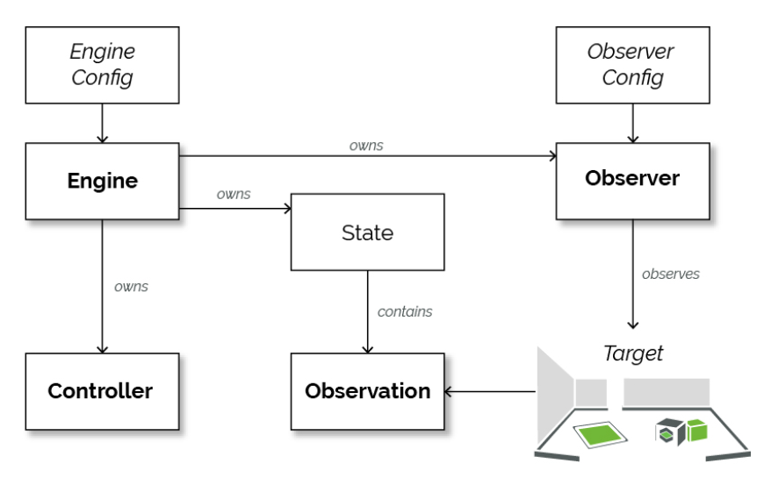

Slide 9
Features of vuforia sdk
Image Recognition
Object Recognition
Multi-target Detection
Virtual Buttons
Augmented Reality Cloud Recognition
Ground Plane Detection

Slide 10
Image target feature
The Image Target feature in the Vuforia SDK allows developers to recognize and track 2D images as triggers for augmented reality (AR) experiences. Here's an overview of the Image Target feature:
Image Recognition
Target Tracking
Multiple Targets
Image Target Database
Extended Tracking
Image Target Sizes and Configurations
Unity Integration

Slide 11
C#
C# is also a popular choice for AR and VR development due to its ease of use, performance, and wide community support. One of the main advantages of C# is its integration with Unity, a popular game engine used for AR and VR development Much of Unity's capabilities come from using C# for programming, a language that works best when building desktop, mobile and VR/AR apps. It's widely used in real-time game development and VR, with over 90% of VR/AR development companies using C#.

Slide 12
C# for scripting
When using the Vuforia SDK for scripting and developing augmented reality (AR) applications, C# is one of the programming languages commonly used. Here's an overview of how C# can be used for scripting with Vuforia:
Unity Integration, Vuforia Unity Extension, Vuforia API, Scripting AR Behaviors, UI Integration, Debugging and Error Handling.
When working with Vuforia and C# scripting, it is recommended to have a good understanding of C# syntax and Unity's scripting concepts. The Vuforia documentation and Unity's resources provide detailed guides and examples to help you get started with scripting AR applications using C#.

Slide 13
Hardware requirements
S. NO. DESCRIPTION TYPE
1 Hardware Window corei5 Processor
2 Clock Speed 2.7GHz
3 RAM 8GB
4 SSD 256GB

Slide 14
Module description

Slide 15
Reports and outputs
CONCLUSION

Slide 16
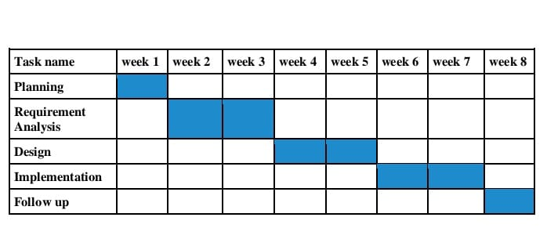
GANTT CHART

Slide 17
THANK YOU

